Slide 1

Overcome the struggle on git with known patterns
Ivan Cipriani

Slide 2
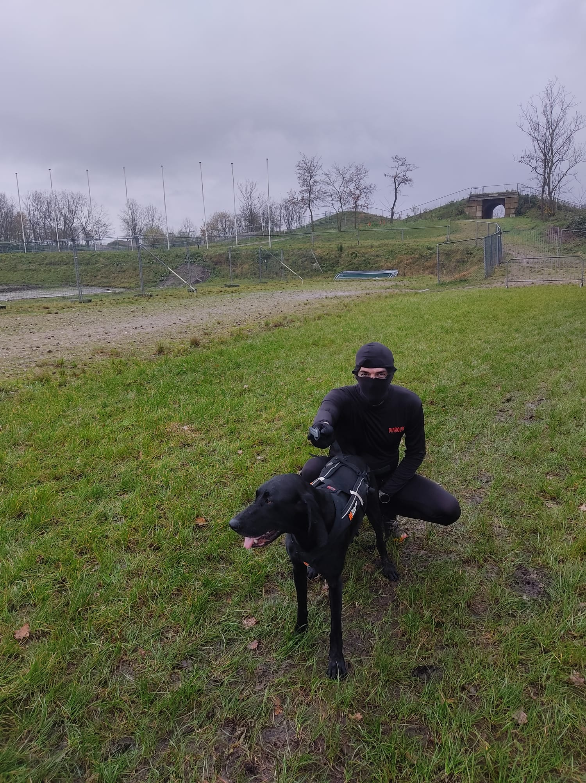

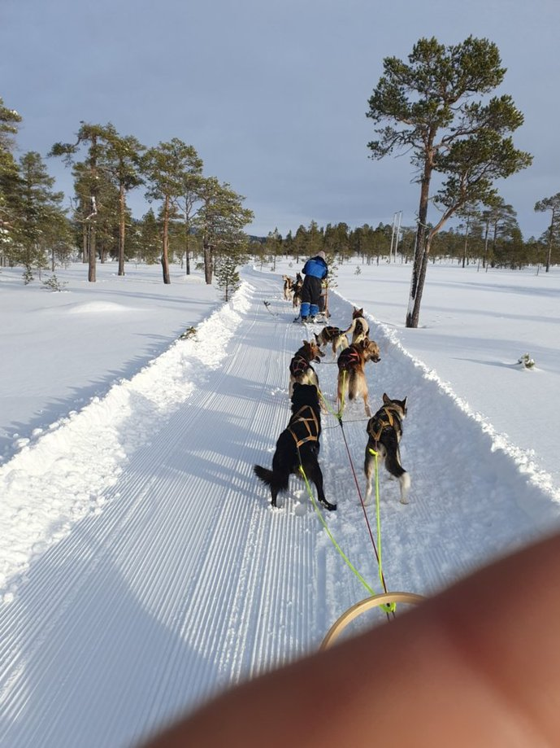


About me
I am a software developer with certification on Microsoft technologies, scrum, tests and dev-ops with a university background in geology with some papers still mentions after 10 years.
In my spare time, I like to run with my dog, hiking in the mountains, ski and support Fiorentina.
Notes:
Cognitive dissonance

Slide 3
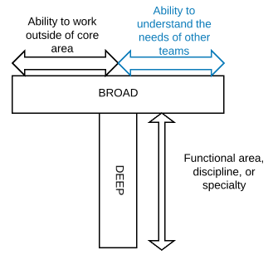






My technical profile

Slide 4

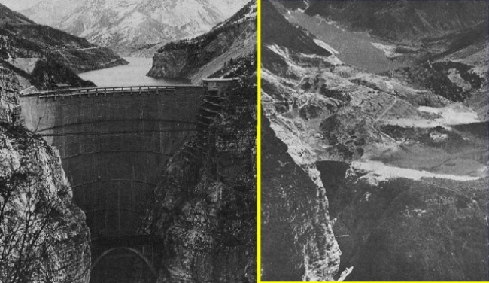

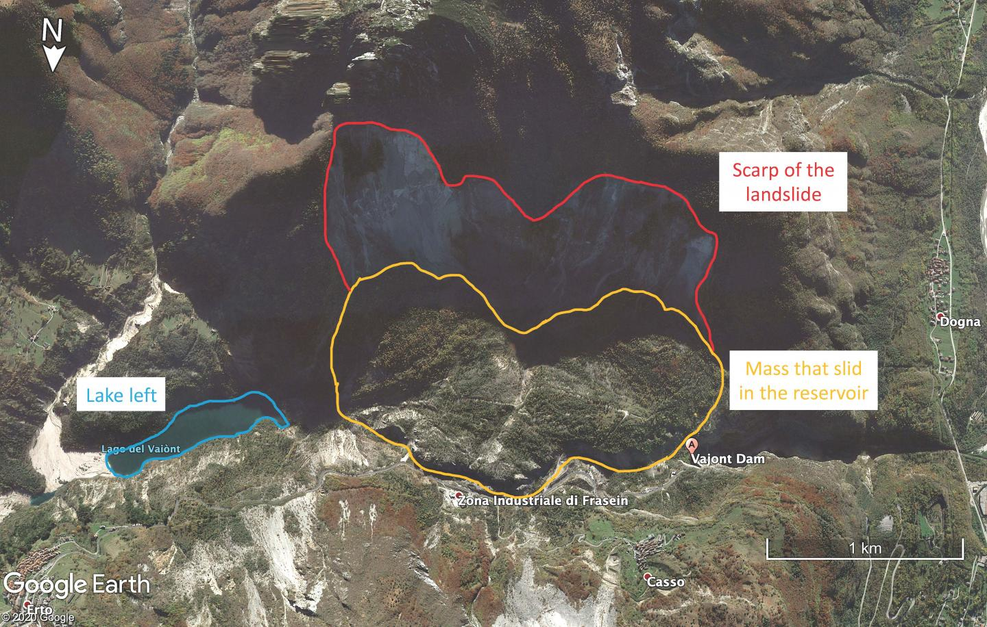
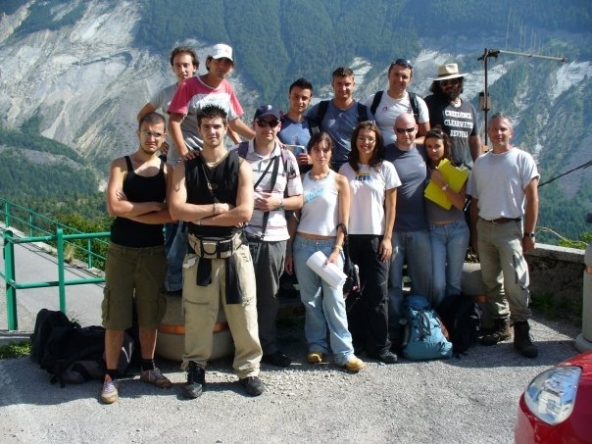
Nuget of geology (I want to emulate Uncle Bob)
Notes:
Il disastro del Vajont (pronuncia: /vaˈjɔnt/[2]) si verificò la sera del 9 ottobre 1963, nel neo-bacino idroelettrico artificiale del torrente Vajont nell'omonima valle (al confine tra Friuli-Venezia Giulia e Veneto), quando una frana precipitò dal soprastante pendio del Monte Toc nelle acque del bacino alpino realizzato con l'omonima diga; la conseguente tracimazione dell'acqua contenuta nell'invaso, con effetto di dilavamento delle sponde del lago, coinvolse prima Erto e Casso, paesi vicini alla riva del lago dopo la costruzione della diga, mentre il superamento della diga da parte dell'onda generata provocò l'inondazione e distruzione degli abitati del fondovalle veneto, tra cui Longarone, e la morte di 1.917 persone, tra cui 487 bambini e adolescenti[3].
Le cause della tragedia, dopo numerosi dibattiti, processi e opere di letteratura, furono ricondotte ai progettisti e dirigenti della SADE, ente gestore dell'opera fino alla nazionalizzazione, i quali occultarono la non idoneità dei versanti del bacino, a rischio idrogeologico. Dopo la costruzione della diga si scoprì infatti che i versanti avevano caratteristiche morfologiche (incoerenza e fragilità) tali da non renderli adatti ad essere lambiti da un serbatoio idroelettrico. Nel corso degli anni l'ente gestore e i suoi dirigenti, pur essendo a conoscenza della pericolosità, anche se supposta inferiore a quella effettivamente rivelatasi, coprirono con dolo i dati a loro disposizione, con il beneplacito di vari enti a carattere locale e nazionale, dai piccoli comuni interessati fino al Ministero dei lavori pubblici.

Slide 5




Why this presentation
Notes:
Why I prepare this presentation because in my first working experience outside Italy in London in 10 minutes I get my first and unique explanation of git and the only in three months before I quit and move to Netherlands. After that I decided to really understand git and this is probably why I like this topic to avoid other people to hate git like me in London ☺
Why you are here. You are here because you found intriguing the description of the event or because your are close to the PG. But for one or the other reason you are here because you want to learn something new on git or understand something deeper on the topic. This is an event thinking for person with some pre-experience on git also already fro several years, if you are a beginner you will probably struggle to follow the whole event but I hope you will get some guidelines to how study git to became not only a user of git but a professional user of git. With this slide I will try to highlighted the purpose of this event and for that I will use some exprresso machine. You can obtain very good coffee with the machine on the left without the need of knowledge about perfect pressure or how to grind the coffee or you can try to go for excellent coffee and use a machine like this (the one that I have at home) but for that you need to understand why the pressure eis important why change setting of the grinder.
With git is the same, you don’t need to understand how the data are saved or optimized in the repository do use the basic and most used function but if you want to use the full potential of git (like to aim to produce a excellent espresso) you need to understand what git is doing on the background.
And of course there will be always something more to learn more before be an SME on the topic so like for me for the coffee to be ready to use a machine like this.

Slide 6
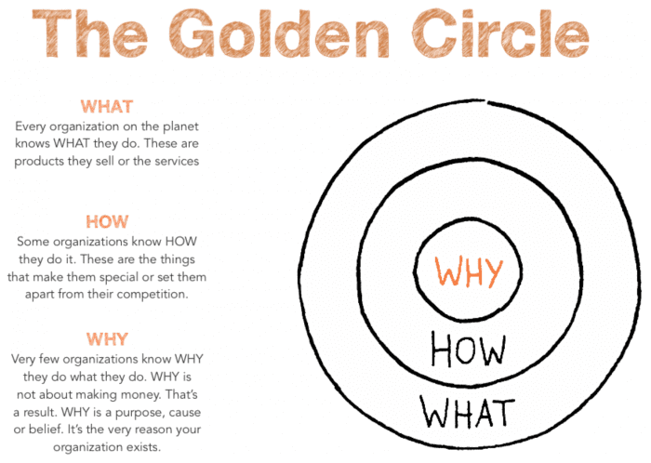
Agenda
What it is Git
Git Overview
Git Repository (Object store)
Git content-addressable database
Visualizing git Object store
Atomic Commit
The three states of a Git Project
Other important topic not in the presentation
Notes:
To make my explanatiuon easier but mainly to make easier to you to understand the information on this hour I will try to show where some pattern where used by the creator of git (intentionally or not that is not important). And of course when you talk of design patter a reference to these four guys is needed also if no one of the design patter mention in the next hour are in this book ☺

Slide 7

https://git-scm.com/​
Notes:
Git is not only for software developer but also for data science, grahic editor, writers etc..
Book refernce

Slide 8
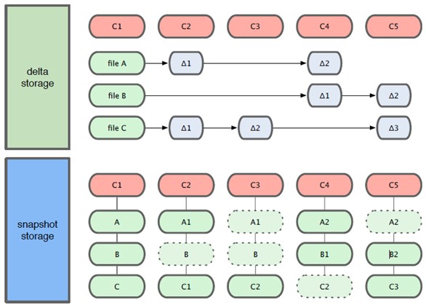
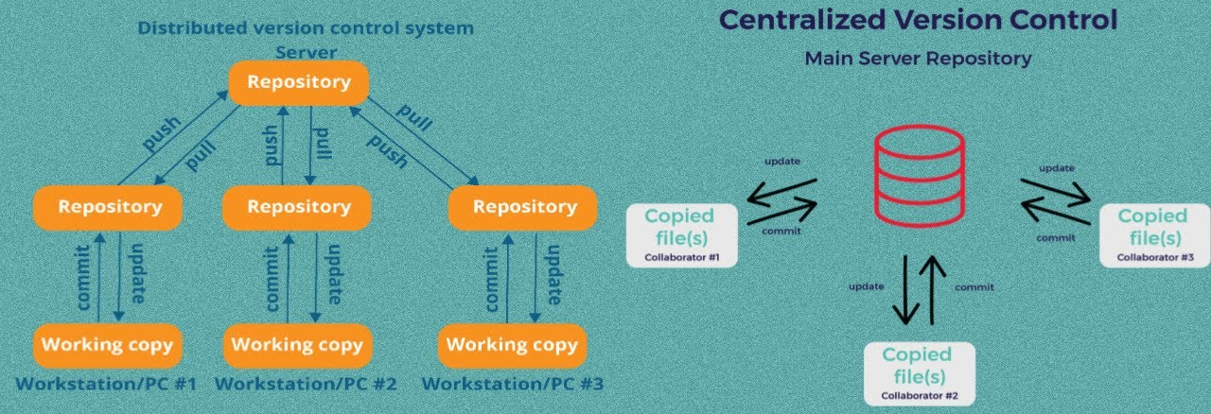
What it is Git
Git is a content tracker
Distributed version control system optimized for local operation
Snapshot of changes not deltas
Git is definitive (procedural language)
Notes:
Local repository allow to work also disconnected from internet
Git is definit command are explicit
Thinking GIT
Git content-addressable database under the hood
To with branching you can work in parallelto your main branch
Procedural Language: In procedural languages, the program code is written as a sequence of instructions. User has to specify “what to do” and also “how to do” (step by step procedure). These instructions are executed in the sequential order. These instructions are written to solve specific problems.
Examples of Procedural languages: FORTRAN, COBOL, ALGOL, BASIC, C and Pascal.
Non-Procedural Language: In the non-procedural languages, the user has to specify only “what to do” and not “how to do”. It is also known as an applicative or functional language. It involves the development of the functions from other functions to construct more complex functions.
Examples of Non-Procedural languages: SQL, PROLOG, LISP.
A commit is a snapshot in time. Each commit contains a pointer to its root tree, representing the state of the working directory at that time. The commit has a list of parent commits corresponding to the previous snapshots. A commit with no parents is a root commit and a commit with multiple parents is a merge commit. Commits also contain metadata describing the snapshot such as author and committer (including name, email address, and date) and a commit message. The commit message is an opportunity for the commit author to describe the purpose of that commit with respect to the parents.

Slide 9
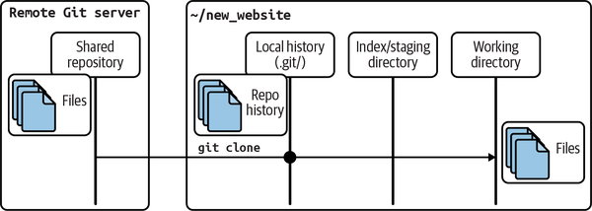
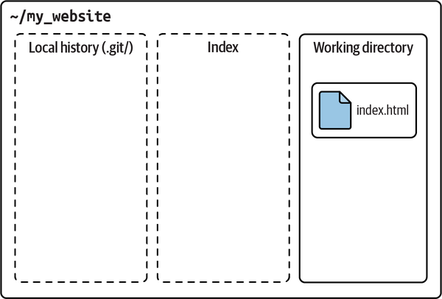
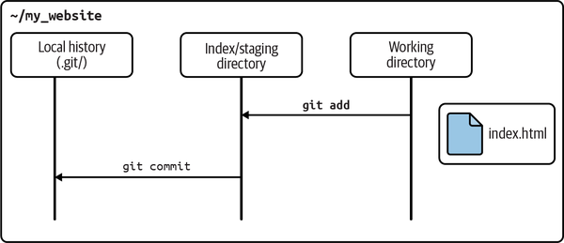
Git Overview
Git hidden folder (local repository)
Local history (commits)
Index (stage)
Working directory
Repository
.git hidden folder
Notes:
Working directory where you alter your files
Local history --> repo history
Shared repository git clone
Working directory is "clean" empty in the image above if equal to the remote one
The repository is essentially the .git hidden folder inside the working directory (workspace).
The working directory (workspace) is essentially your project folder.
Also note the term directory is basically synonymous to the term folder.

Slide 10
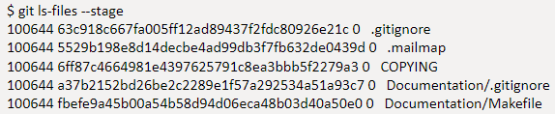
Git Overview
Index (Stage)
Separation between incremental steps and the commit of those change
Useful also in merge operation allowing multiple version of the same file to be manage inspected and manipulated
It is private to your repository
It is transitory information
It is like a cache
1. git add
Ramdom modification
Ramdom modification
2. New changes
Other modification
Notes:
This concept it will be important later in another slide
Key distinguish feature pf git
Does not create a tree for your objets creted but update git/index
Index contain the list of all the file --> objects in the .git git ls-files –stage
Do not create an object for the tree you can see only file and path of the file
Git commit check the index to see what to commit
Do not care of the name of the file only of the content
Rappresnt a tree object candidate to be a commit
List of pathnames with persmission and reference to objects in the .git/objects folder (file or other tree)
The index is a binary file (generally kept in .git/index) containing a sorted list of path names, each with permissions and the SHA1 of a blob object; git ls-files can show you the contents of the index:
$ git ls-files --stage 100644 63c918c667fa005ff12ad89437f2fdc80926e21c 0 .gitignore 100644 5529b198e8d14decbe4ad99db3f7fb632de0439d 0 .mailmap 100644 6ff87c4664981e4397625791c8ea3bbb5f2279a3 0 COPYING 100644 a37b2152bd26be2c2289e1f57a292534a51a93c7 0 Documentation/.gitignore 100644 fbefe9a45b00a54b58d94d06eca48b03d40a50e0 0 Documentation/Makefile ... 100644 2511aef8d89ab52be5ec6a5e46236b4b6bcd07ea 0 xdiff/xtypes.h 100644 2ade97b2574a9f77e7ae4002a4e07a6a38e46d07 0 xdiff/xutils.c 100644 d5de8292e05e7c36c4b68857c1cf9855e3d2f70a 0 xdiff/xutils.h
Note that in older documentation you may see the index called the "current directory cache" or just the "cache". It has three important properties:
The index contains all the information necessary to generate a single (uniquely determined) tree object.
For example, running git commit generates this tree object from the index, stores it in the object database, and uses it as the tree object associated with the new commit.
The index enables fast comparisons between the tree object it defines and the working tree.
It does this by storing some additional data for each entry (such as the last modified time). This data is not displayed above, and is not stored in the created tree object, but it can be used to determine quickly which files in the working directory differ from what was stored in the index, and thus save git from having to read all of the data from such files to look for changes.
It can efficiently represent information about merge conflicts between different tree objects, allowing each pathname to be associated with sufficient information about the trees involved that you can create a three-way merge between them.
During a merge, the index can store multiple versions of a single file (called "stages"). The third column in the git ls-files output above is the stage number, and will take on values other than 0 for files with merge conflicts.
The index is thus a sort of temporary staging area, which is filled with a tree which you are in the process of working on.

Slide 11
Git repository
Four type of objects in the Object store
Blobs
Each version of a file is represented as a blob (opaque) and does not contain any metadata included the name
Trees
A tree object represents one level of directory information. It records blob identifiers, pathname and bit of metadata in one directory. It can also refer another tree so to create complex structure
Commits
A commit object holds metadata for each change introduce into the repository. Each commit point to a tree object that capture the state (snapshot) of the repository at that time
Tags
A tag object assigns a human readable name to a specific object mainly commits
Immutable
Notes:
It contain all the information to retieve the whole history and revision
Here object store
Make easy to clone
Contains data file log message author information dates ans all the information need to recreate the project state at a given moment in time
Zlib to package files
Commit rappresent a snapshot of all the files but only the one modifies or added are stored in a separated object and reuse the other blob

Slide 12
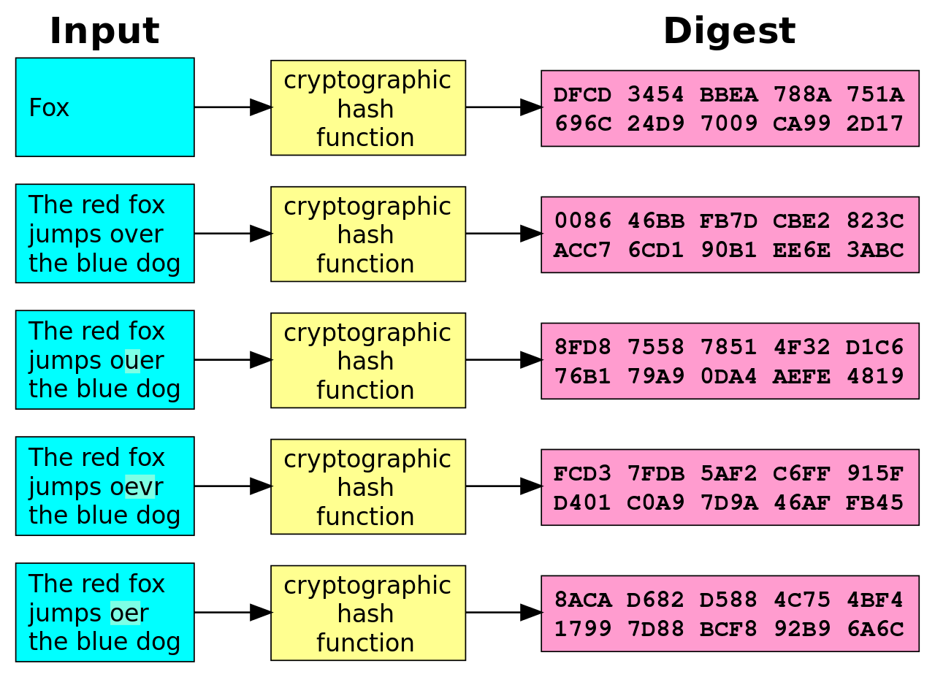
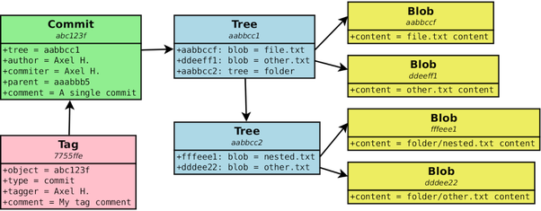
GIT Content-addressable database
Objects are stored in key-value pairs
Git store the whole content of the file not the difference
The key is an SHA1 hash value
Git use the whole content of the object to generate this key (but not file name)
The same content always the same key (True function)
Collision of sha1 is almost impossible
The path and name of the files are saved in the tree objects
Notes:
So two files with the same content are identical and treated like on object
Commit is not identical to other commit in the world because they have date and name of the author… still possible but…
If you hired a trillion of people to produce a trillion new unique blobs per second per a trillion years only 10 elevate to 43 and you have about 10 elvetae 48 with 160 bits
It is a collision only if two different content create the same hash
Like in angular for redux NgRx
Pure Function: A pure function as a function that doesn’t have an internal state. It means that all operations it performs are not affected by that state and given the same input parameters and produces the same deterministic output.
Store: Your application’s state is maintained in the store. The store is immutable.
Reducers: Reducers are functions that take the current state and an action as arguments, and return a new state result to store. In other words, (state, action) => newState
Actions: Actions are unique events that can be dispatched from a component or service.
Selectors: are pure functions used to select, derive and compose pieces of state.
Effects: occur as a result from actions, and can also create actions when called. Effects primary responsibility is to create async side-effects (like service calls to APIs), that ultimately generate other actions.
In Redux, reducers are pure functions that handle state logic, accepting the initial state and action type to update and return the state, facilitating changes in React view components.
A function is said to be pure if the return value is determined by its input values only and the return value is always the same for the same input values or arguments.

Slide 13
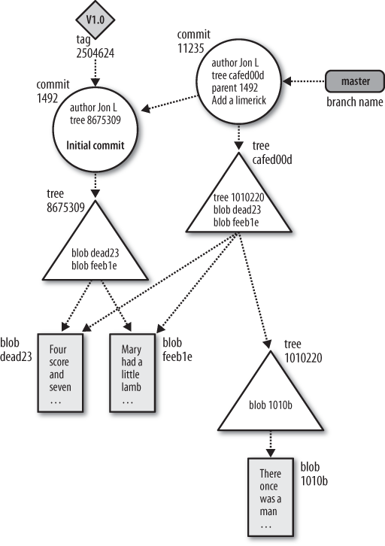
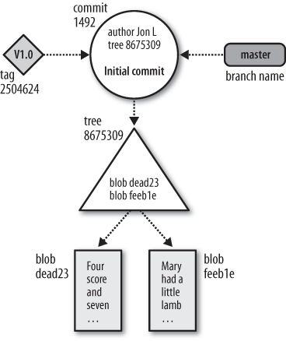
Visualizing git Object store
Time
Notes:
It contain all the information to retrieve the whole history and revision
Here object store
Make easy to clone
Contains data file log message author information dates ans all the information need to recreate the project state at a given moment in time
Branch is not an object in git
This is DAG for the commit
DRY --> new tree points to the same object if identical so store only file that are changed (in some way like for delta we store only difference but in file level)
Memento pattern to restore the state of the object to a previuos state
In Git, a ref is a human readable name that references a Git commit ID. A ref is essentially a pointer to a commit. Examples of refs are Git branch names such as master and dev. Another example of refs are Git tags such as v0.1 or v0.2. You can think of each of these as a variable name that points to a commit ID. The commit ID that a ref points to is dynamic so it can change over time.
as a global variable or environment variable

Slide 14
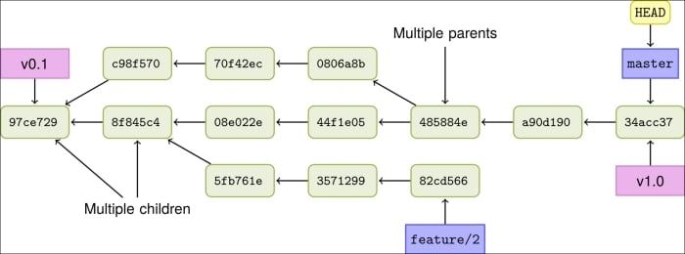
Visualizing git Object store
Show evolution of graph DAG
Notes:
Direct acyclic graph each node is direct from an earlier node is a single direction. No possible to come back to a previous node (not important of time)
Remember difference index and object store
Different commit object can point to the same tree
Not important time of commits
Th eroot commit is the only one with no parent commit
A merge commit can have more then on parent commit
A commit with one of more child is where a diverge is starting
A directed acyclic graph (DAG) is a conceptual representation of a series of activities. The order of the activities is depicted by a graph, which is visually presented as a set of circles, each one representing an activity, some of which are connected by lines, which represent the flow from one activity to another. Each circle is known as a “vertex” and each line is known as an “edge.” “Directed” means that each edge has a defined direction, so each edge necessarily represents a single directional flow from one vertex to another. “Acyclic” means that there are no loops (i.e., “cycles”) in the graph, so that for any given vertex, if you follow an edge that connects that vertex to another, there is no path in the graph to get back to that initial vertex.

Slide 15
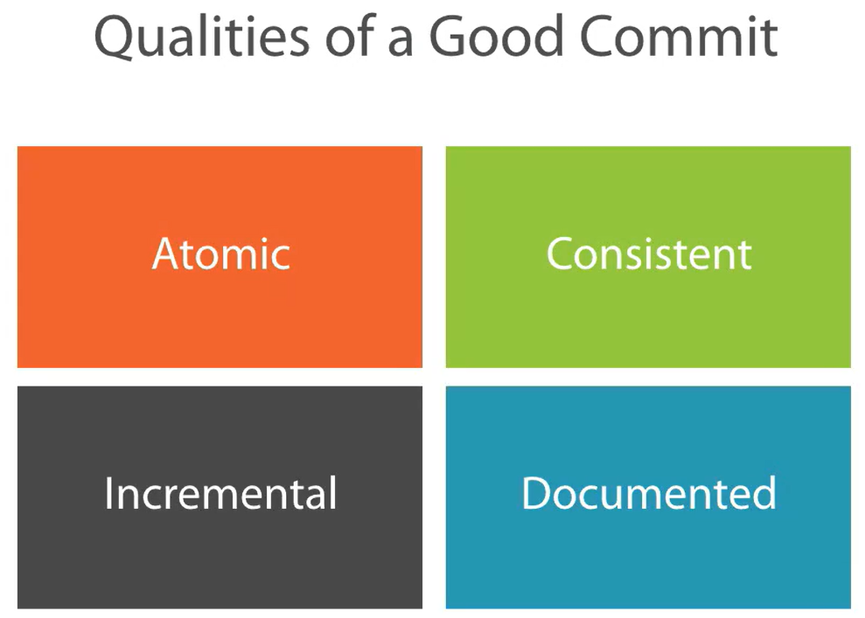
Atomic commit
Notes:
A commit is a snashot capturing the current state of a repository at a moment in time like a photos, is not a Delta of changes. So a commit is the whole project. Is immutable. Commit point to a tree the tree point to blobs or other tree and has metdata on the blob.
How to achive that through a rebase interactive if you have bad commit
Use the index to be ready to create a commit

Slide 16
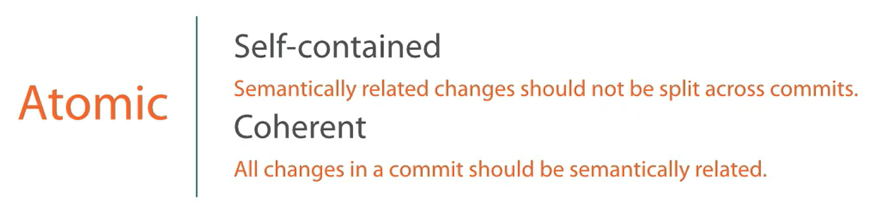
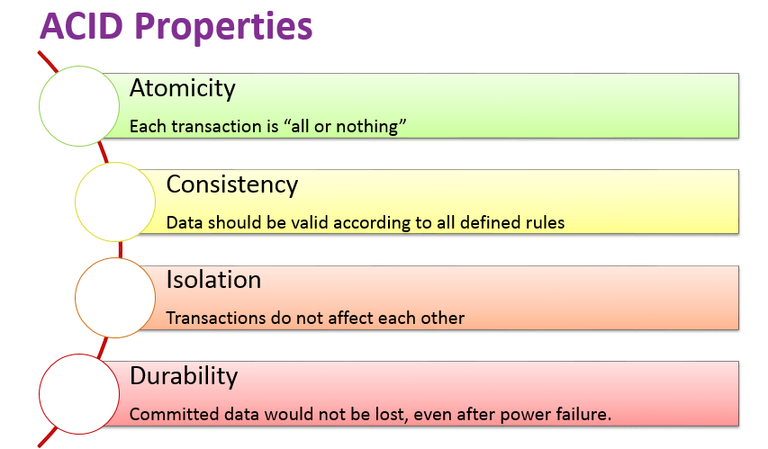
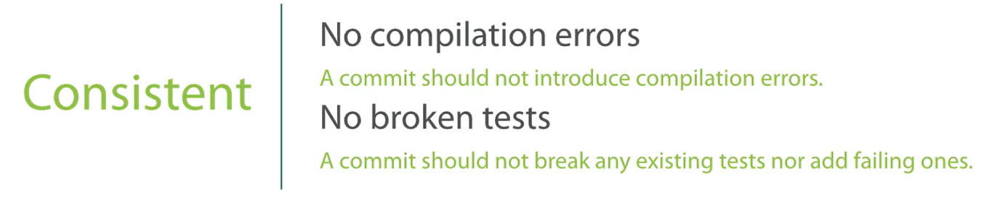
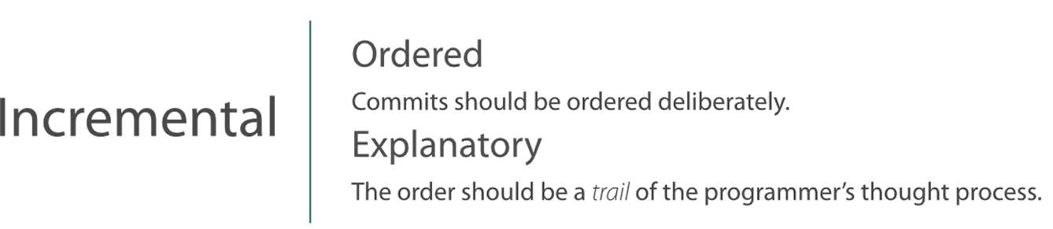
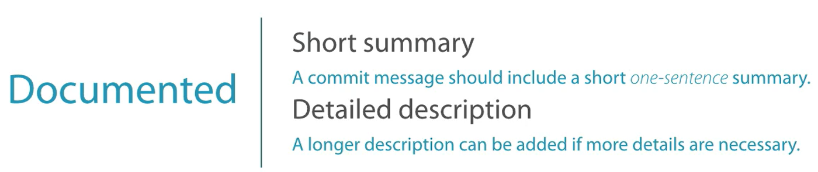
Atomic commit
Notes:
Do not remove something in one commit and add that in a second commit difficult to see bot atomic
Realistic hystoric every commit is retained and nothing is changed
fine grained
didactic only best work
Pay attention to clean history if you are not alone of work on that branch
Use always Push with lease so that if there are new change in the remote repo you will be notify

Slide 17
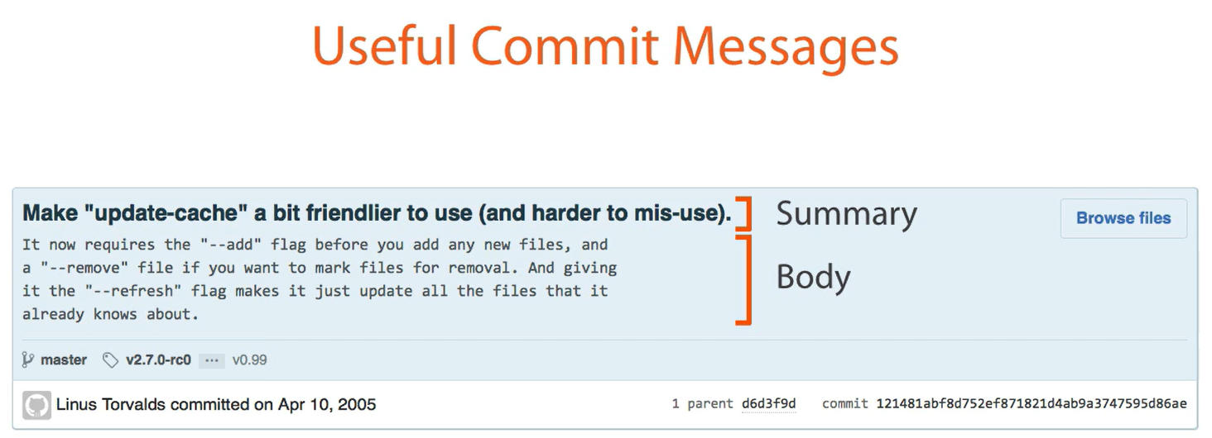
Atomic commit
Does Self-Documenting Code Actually Exist?
Probably not but we have to aim to that
Notes:
Can be set a template in git extension

Slide 18
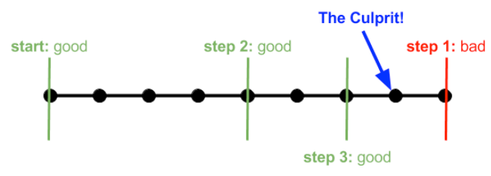
Atomic commit
Git Bisect
A toll included with Git that enables you to specify a start and end commit and either manually or automatically determine the point of failure with that range of commits
Notes:
Bynary search algorithm
You can use a script or sayd god badi

Slide 19
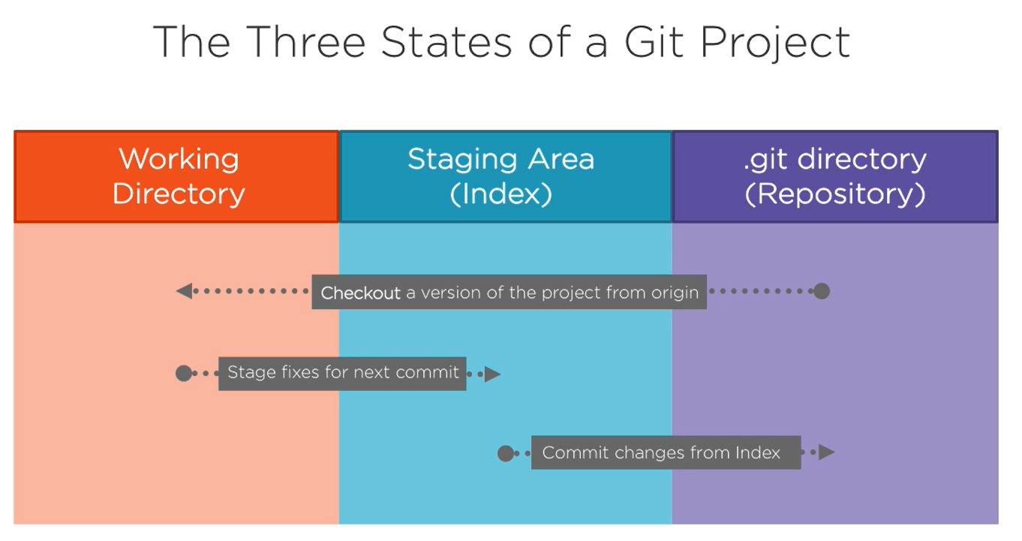
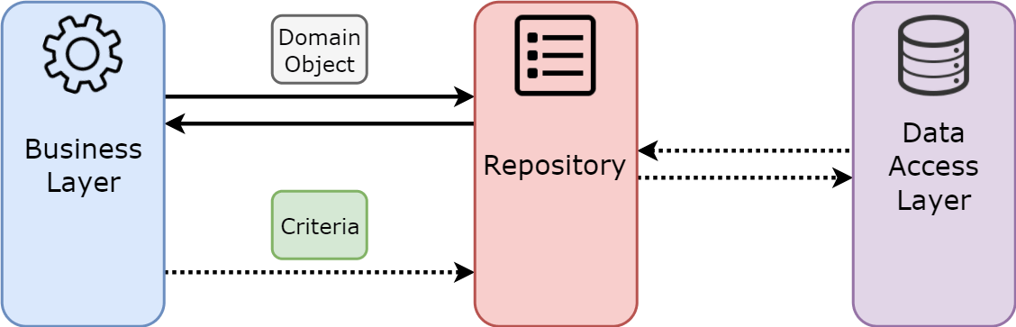
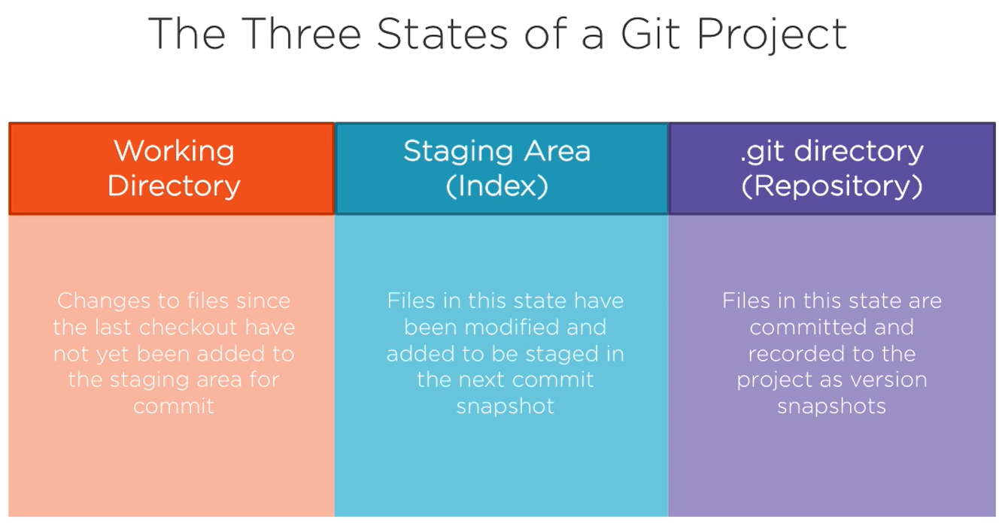
The Three States of a Git Project
Repository design pattern

Slide 20
Other important topic not in the presentation
Garbage collector like in c#
Hook (like attribute or middleware in c#)
Submodules like nuget package subtree is not
Difference in git moment pattern
Git branching like pointer in C++ or delegate in c#
Patch
Notes:
So subtrees

Slide 21
Thank you!
Ivan Cipriani

